Slide 1
UNIT-2 (C4.5)

Slide 2
What is C4.5?
C4.5 algorithm is improvement over ID3 algorithm, where “C” is shows algorithm is written in C and 4.5 specifics version of algorithm.
splitting criterion used by C4.5 is the normalized information gain (difference in entropy).
The attribute with the highest normalized information gain is chosen to make the decision.
GainRatio(A) = Gain(A) / SplitInfo(A)
SplitInfo(A) = -∑ |Dj|/|D| x log|Dj|/|D|

Slide 3
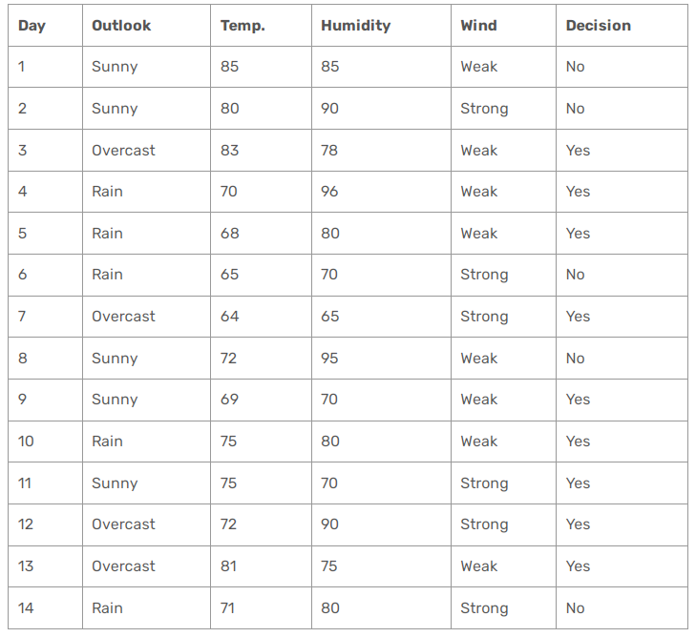
Example:

Slide 4
Entropy(Decision) = ∑ — p(I) . log p(I) = — p(Yes) . log p(Yes) — p(No) . log2(No)
= — (9/14) . log(9/14) — (5/14) . log(5/14) = 0.940
Here, we need to calculate gain ratios instead of gains.
GainRatio(A) = Gain(A) / SplitInfo(A)
SplitInfo(A) = -∑ |Dj|/|D| x log|Dj|/|D|

Slide 5
Let’s calculate for Wind Attribute:
Gain(Decision, Wind) = Entropy(Decision) — ∑ ( p(Decision|Wind) . Entropy(Decision|Wind) )
Gain(Decision, Wind) = Entropy(Decision) — [ p(Decision|Wind=Weak) . Entropy(Decision|Wind=Weak) ] + [ p(Decision|Wind=Strong) . Entropy(Decision|Wind=Strong) ]
Entropy(Decision|Wind=Weak) = — p(No) . logp(No) — p(Yes) . logp(Yes) = — (2/8) . log(2/8) — (6/8) . log(6/8) = 0.811
Entropy(Decision|Wind=Strong) = — (3/6) . log(3/6) — (3/6) . log(3/6) = 1
Gain(Decision, Wind) = 0.940 — (8/14).(0.811) — (6/14).(1) = 0.940–0.463–0.428 = 0.049
There are 8 decisions for weak wind, and 6 decisions for strong wind.
SplitInfo(Decision, Wind) = -(8/14).log(8/14) — (6/14).log(6/14) = 0.461 + 0.524 = 0.985
GainRatio(Decision, Wind) = Gain(Decision, Wind) / SplitInfo(Decision, Wind) = 0.049 / 0.985 = 0.049

Slide 6
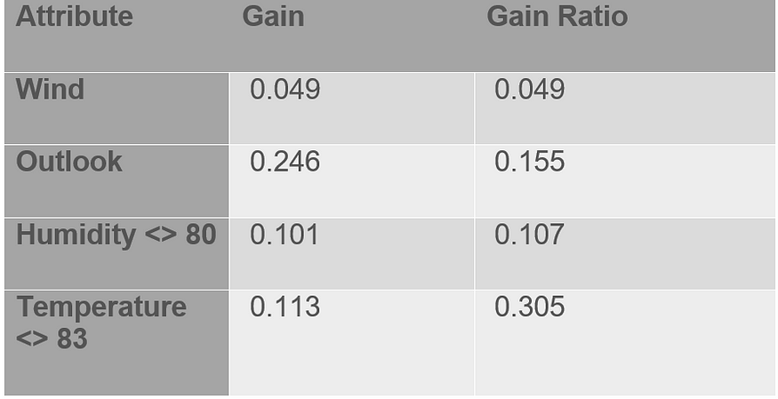
Similarly, calculate gain ratio for outlook, humidity, and temperature
Attribute having highest Gain Ratio will be selected as Root node.

Slide 7
Thank you!

